Slide 1
Advanced NLP Platform for News Intelligence
Student: Yunze Wu
Course: ITAI 2373 – Natural Language Processing
Dataset: BBC News Classification Dataset

Slide 2
Project Overview
Goal:
Build a production-ready NLP system capable of analyzing, classifying, summarizing, retrieving, and interacting with news articles.
Key Capabilities:
Text preprocessing & TF-IDF modeling
Enhanced classification (LogReg + tuning)
Topic modeling (LDA)
VADER sentiment analysis
Semantic search
Extractive summarization
Multilingual processing
Conversational interface
Dataset: ~1500 BBC News articles (5 categories)

Slide 3
System Architecture
Pipeline Components:
Data preprocessing
TF-IDF vectorization
Multi-class classification
Topic modeling
Sentiment analysis
Summarization & semantic search
Translation module
Conversational interface
Flow:
Raw Text → Preprocess → Vectorize → ML Models → Insights → User Interaction

Slide 4
Preprocessing & TF-IDF
Preprocessing Steps:
Lowercasing
Tokenization
Stopword removal
Lemmatization
Cleaning punctuation & non-alphabetic tokens
Feature Extraction:
TF-IDF (max_features=5000, ngram_range=(1,2))
Used for classification & semantic search

Slide 5
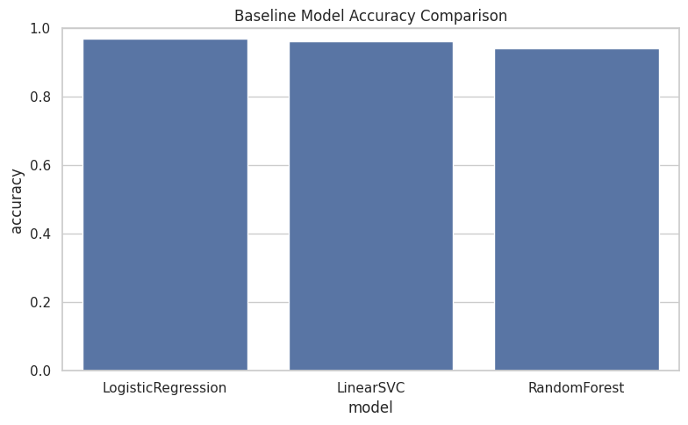
Multi-Class Classification Results
Models tested:
Logistic Regression
Linear SVC
Random Forest
Tuned Logistic Regression (GridSearch)
Outcome:
Tuned Logistic Regression achieved highest accuracy
LinearSVC stable but slightly lower
Random Forest not ideal for sparse text
Key Insight:
Linear models perform best on TF-IDF features.

Slide 6
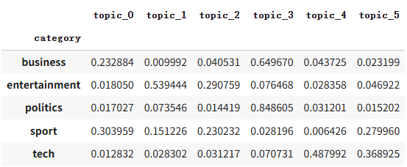
Topic Modeling with LDA
Purpose:
Discover hidden thematic structure in news articles.
Method:
LDA with 6 topics using CountVectorizer.
Findings:
Business: market, company, profit
Sports: win, match, team
Politics: election, ministers, policy
Tech: software, mobile, users

Slide 7
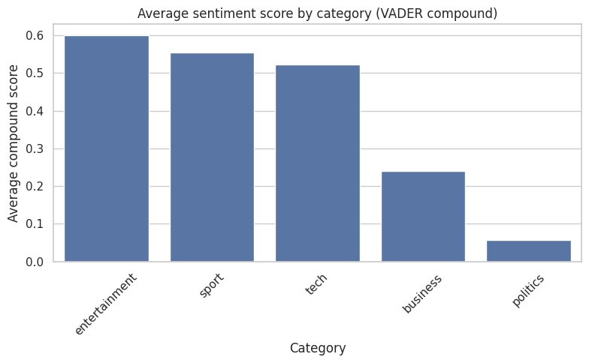
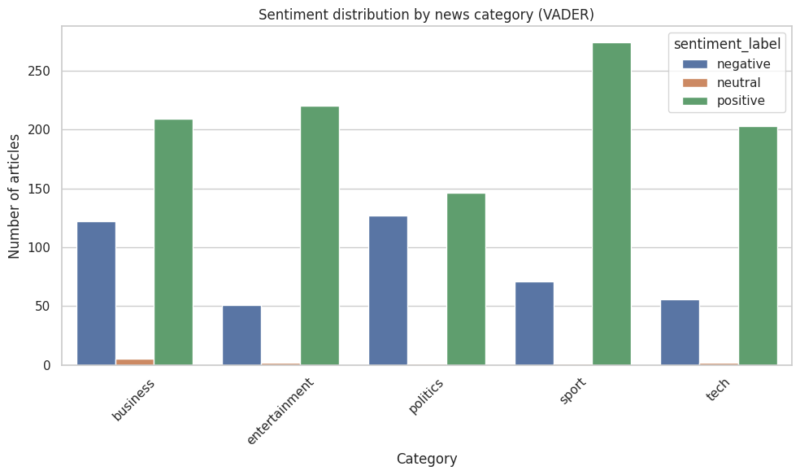
Sentiment Analysis Overview
Tool: VADER (rule-based sentiment scoring)
Outputs:
Compound sentiment score
Positive / neutral / negative labels
Insights:
Entertainment shows more positive tone
Politics articles skew neutral
Business varies depending on news context

Slide 8
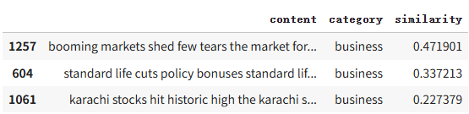
Summarization & Semantic Search
Extractive Summarization
Scores sentences using word frequency
Selects highest-ranked sentences
Semantic Search
Uses cosine similarity over TF-IDF vectors
Retrieves most relevant articles to a query
Value:
Supports content discovery, recommendation systems, and editorial workflows.

Slide 9
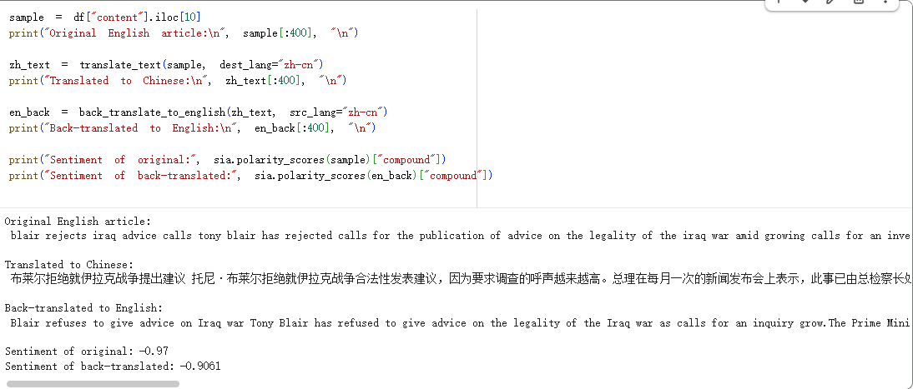
Multilingual Intelligence
Features implemented:
Translate English → Chinese
Translate back Chinese → English
Compare meaning & sentiment before/after translation
Observations:
Some semantic drift appears
Sentiment may slightly shift
Demonstrates pipeline adaptability for global news monitoring

Slide 10
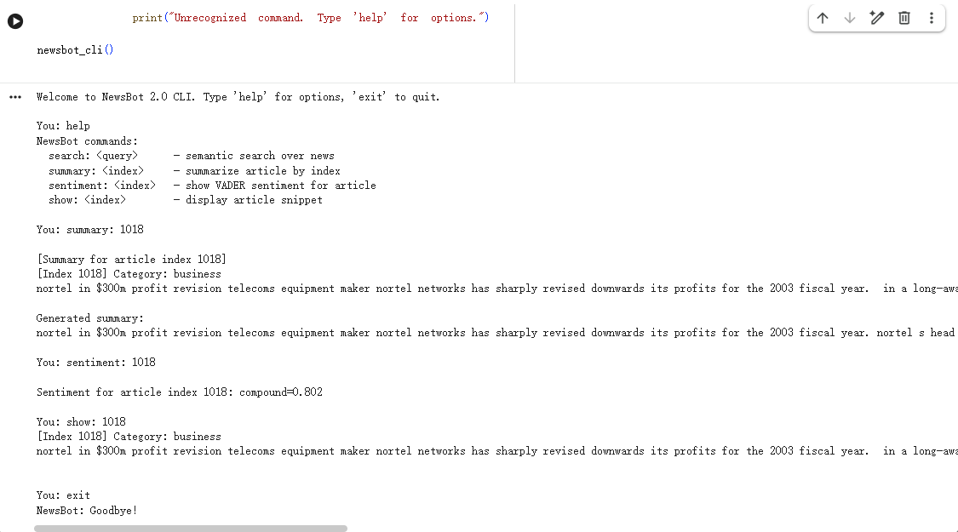
Conversational Interface Prototype
Capabilities:
Users can type commands such as:
search: <query>
summary: <index>
sentiment: <index>
show: <index>
Purpose:
Prototype of an interactive NLP assistant for news analysts.
Notes:
Designed as CLI in Colab
Serves as foundation for future chatbot or web interface

Slide 11
Key Challenges & Lessons Learned
Challenges:
Sparse TF-IDF features required careful model selection
Topic modeling sensitive to preprocessing
Translation inconsistencies
CLI limitations in Colab environment
Lessons:
Modular design greatly improves scalability
Traditional NLP still powerful when combined properly
Semantic search and summarization dramatically increase usability

Slide 12
Future Enhancements
Transformer summarization (BART/T5)
Dense embeddings for search (Sentence-BERT)
Multilingual classification (mBERT/XLM-R)
Full deployment via FastAPI + Streamlit
Real-time news ingestion + dashboards

Slide 13
Conclusion
NewsBot Intelligence System 2.0 demonstrates an integrated and extensible NLP pipeline capable of real-world news analytics. The project synthesizes classification, topic modeling, sentiment analysis, summarization, semantic retrieval, translation, and interactive querying into a cohesive system. It highlights the power of modern NLP tools and their applicability to media monitoring and information intelligence.

